Slide 1
Unit 5
Unsupervised learning

Slide 4
What is Clustering?
Attach label to each observation or data points in a set
You can say this “unsupervised classification”
Clustering is alternatively called as “grouping”
Intuitively, if you would want to assign same label to a data points that are “close” to each other
Thus, clustering algorithms rely on a distance metric between data points
Sometimes, it is said that for clustering, the distance metric is more important than the clustering algorithm

Slide 5
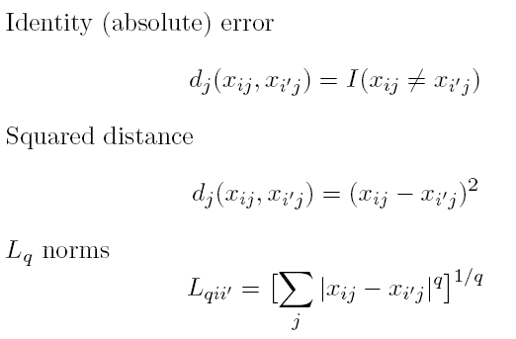
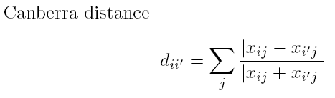
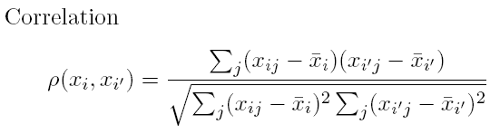
Distances: Quantitative Variables
Data point:
Some examples

Slide 6
Types of clustering:
Hierarchical algorithms: these find successive clusters
using previously established clusters.
1. Agglomerative ("bottom-up"): Agglomerative algorithms begin with each element as a separate cluster and merge them into successively larger clusters.
2. Divisive ("top-down"): Divisive algorithms begin with the whole set and proceed to divide it into successively smaller clusters.
2. Partitional clustering: Partitional algorithms determine all clusters at once. They include:
K-means and derivatives
Fuzzy c-means clustering
QT clustering algorithm

Slide 7
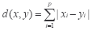
Common Distance measures:
Distance measure will determine how the similarity of two elements is calculated and it will influence the shape of the clusters.
They include:
1. The Euclidean distance (also called 2-norm distance) is given by:
2. The Manhattan distance (also called taxicab norm or 1-norm) is given by:

Slide 8
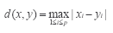
3.The maximum norm is given by:
4. The Mahalanobis distance corrects data for different scales and correlations in the variables.
5. Inner product space: The angle between two vectors can be used as a distance measure when clustering high dimensional data
6. Hamming distance (sometimes edit distance) measures the minimum number of substitutions required to change one member into another.

Slide 9
K-MEANS CLUSTERING
The k-means algorithm is an algorithm to cluster n objects based on attributes into k partitions, where k < n.
It is similar to the expectation-maximization algorithm for mixtures of Gaussians in that they both attempt to find the centers of natural clusters in the data.
It assumes that the object attributes form a vector space.

Slide 10
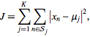
An algorithm for partitioning (or clustering) N data points into K disjoint subsets S_{j} containing data points so as to minimize the sum-of-squares criterion
where x_{n} is a vector representing the the n^{th} data point and u_{j} is the geometric centroid of the data points in S_{j}.

Slide 11
Simply speaking k-means clustering is an algorithm to classify or to group the objects based on attributes/features into K number of group.
K is positive integer number.
The grouping is done by minimizing the sum of squares of distances between data and the corresponding cluster centroid.

Slide 12
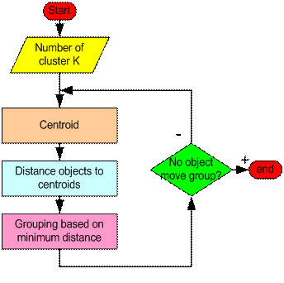
How the K-Mean Clustering algorithm works?

Slide 13
Step 1: Begin with a decision on the value of k = number of clusters .
Step 2: Put any initial partition that classifies the data into k clusters. You may assign the training samples randomly,or systematically as the following:
1.Take the first k training sample as single- element clusters
2. Assign each of the remaining (N-k) training sample to the cluster with the nearest centroid. After each assignment, recompute the centroid of the gaining cluster.

Slide 14
Step 3: Take each sample in sequence and compute its distance from the centroid of each of the clusters. If a sample is not currently in the cluster with the closest centroid, switch this sample to that cluster and update the centroid of the cluster gaining the new sample and the cluster losing the sample.
Step 4 . Repeat step 3 until convergence is achieved, that is until a pass through the training sample causes no new assignments.

Slide 15
A Simple example showing the implementation of k-means algorithm (using K=2)

Slide 19
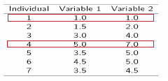
Step 1:
Initialization: Randomly we choose following two centroids (k=2) for two clusters.
In this case the 2 centroid are: m1=(1.0,1.0) and m2=(5.0,7.0).

Slide 20
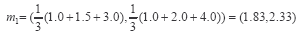
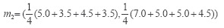
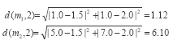
Step 2:
Thus, we obtain two clusters containing:
{1,2,3} and {4,5,6,7}.
Their new centroids are:

Slide 21
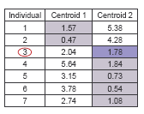
Step 3:
Now using these centroids we compute the Euclidean distance of each object, as shown in table.
Therefore, the new clusters are:
{1,2} and {3,4,5,6,7}
Next centroids are: m1=(1.25,1.5) and m2 = (3.9,5.1)

Slide 22
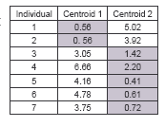
Step 4 :
The clusters obtained are:
{1,2} and {3,4,5,6,7}
Therefore, there is no change in the cluster.
Thus, the algorithm comes to a halt here and final result consist of 2 clusters {1,2} and {3,4,5,6,7}.

Slide 23
PLOT

Slide 24
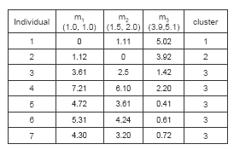
(with K=3)
Step 1
Step 2

Slide 25
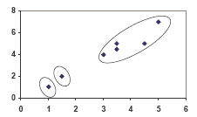
PLOT

Slide 26
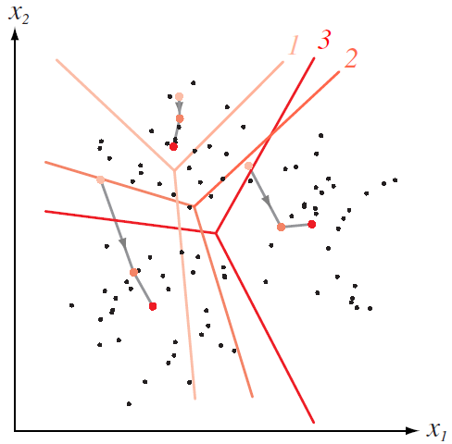
How K-means partitions?
When K centroids are set/fixed,
they partition the whole data space into K mutually exclusive subspaces to form a partition.
A partition amounts to a
Changing positions of centroids leads to a new partitioning.
Voronoi Diagram

Slide 27
K-means: Pros & Cons
Algorithmically, very simple to implement
K-means converges, but it finds a local minimum of the cost function
Works only for numerical observations
K is a user input; alternatively BIC (Bayesian information criterion) or MDL (minimum description length) can be used to estimate K
Outliers can considerable trouble to K-means

Slide 28
Convergence
Why should the K-means algorithm ever reach a fixed point?
A state in which clusters don’t change.
K-means is a special case of a general procedure known as the Expectation Maximization (EM) algorithm.
EM is known to converge.
Theoretically, number of iterations could be large.
Typically converges quickly

Slide 29
Time Complexity
Computing distance between doc and cluster is O(m) where m is the dimensionality of the vectors.
Reassigning clusters: O(Kn) distance computations, or O(Knm).
Computing centroids: Each doc gets added once to some centroid: O(nm).
Assume these two steps are each done once for I iterations: O(IKnm).

Slide 30
Seed Choice
Results can vary based on random seed selection.
Some seeds can result in poor convergence rate, or convergence to sub-optimal clusterings.
Select good seeds using a heuristic (e.g., doc least similar to any existing mean)
Try out multiple starting points
Initialize with the results of another method.

Slide 31
How Many Clusters?
Number of clusters K is given
Partition n docs into predetermined number of clusters
Finding the “right” number of clusters is part of the problem
Given data, partition into an “appropriate” number of subsets.
E.g., for query results - ideal value of K not known up front - though UI may impose limits.
Can usually take an algorithm for one flavor and convert to the other.

Slide 32
K not specified in advance
Say, the results of a query.
Solve an optimization problem: penalize having lots of clusters
application dependent, e.g., compressed summary of search results list.
Tradeoff between having more clusters (better focus within each cluster) and having too many clusters

Slide 33
K not specified in advance
Given a clustering, define the Benefit for a doc to be some inverse distance to its centroid
Define the Total Benefit to be the sum of the individual doc Benefits.

Slide 34
Penalize lots of clusters
For each cluster, we have a Cost C.
Thus for a clustering with K clusters, the Total Cost is KC.
Define the Value of a clustering to be =
Total Benefit - Total Cost.
Find the clustering of highest value, over all choices of K.
Total benefit increases with increasing K. But can stop when it doesn’t increase by “much”. The Cost term enforces this.

Slide 35
K-medoids Clustering
K-means is appropriate when we can work with Euclidean distances
Thus, K-means can work only with numerical, quantitative variable types
Euclidean distances do not work well in at least two situations
Some variables are categorical
Outliers can be potential threats
A general version of K-means algorithm called K-medoids can work with any distance measure
K-medoids clustering is computationally more intensive

Slide 36
K-medoids Algorithm
Step 1: For a given cluster assignment C, find the observation in the cluster minimizing the total distance to other points in that cluster:
Step 2: Assign
Step 3: Given a set of cluster centers {m₁, …, m_{K}}, minimize the total error by assigning each observation to the closest (current) cluster center:
Iterate steps 1 to 3

Slide 37
K-medoids Summary
Generalized K-means
Computationally much costlier that K-means
Apply when dealing with categorical data
Apply when data points are not available, but only pair-wise distances are available
Converges to local minimum

Slide 38
Hierarchical Clustering
Build a tree-based hierarchical taxonomy (dendrogram) from a set of documents.
animal
vertebrate
invertebrate
fish reptile amphib. mammal worm insect crustacean
How could you do this with k-means?

Slide 39
Hierarchical Clustering algorithms
Agglomerative (bottom-up):
Start with each document being a single cluster.
Eventually all documents belong to the same cluster.
Divisive (top-down):
Start with all documents belong to the same cluster.
Eventually each node forms a cluster on its own.
Could be a recursive application of k-means like algorithms
Does not require the number of clusters k in advance
Needs a termination/readout condition

Slide 40
Hierarchical Agglomerative Clustering (HAC)
Assumes a similarity function for determining the similarity of two instances.
Starts with all instances in a separate cluster and then repeatedly joins the two clusters that are most similar until there is only one cluster.
The history of merging forms a binary tree or hierarchy.

Slide 41
Dendogram: Hierarchical Clustering
Clustering obtained by cutting the dendrogram at a desired level: each connected component forms a cluster.

Slide 42
Hierarchical Agglomerative Clustering (HAC)
Starts with each doc in a separate cluster
then repeatedly joins the closest pair of clusters, until there is only one cluster.
The history of merging forms a binary tree or hierarchy.
How to measure distance of clusters??

Slide 43
Closest pair of clusters
Many variants to defining closest pair of clusters
Single-link
Distance of the “closest” points (single-link)
Complete-link
Distance of the “furthest” points
Centroid
Distance of the centroids (centers of gravity)
(Average-link)
Average distance between pairs of elements

Slide 44
Single Link Agglomerative Clustering
Use maximum similarity of pairs:
Can result in “straggly” (long and thin) clusters due to chaining effect.
After merging c_{i} and c_{j}, the similarity of the resulting cluster to another cluster, c_{k}, is:

Slide 45
Single Link Example

Slide 46
Example Single link
 | X | Y
P1 | 0.4 | 0.53
P2 | 0.22 | 0.38
P3 | 0.35 | 0.32
P4 | 0.26 | 0.19
P5 | 0.08 | 0.41
P6 | 0.45 | 0.30

Slide 47
 | P1 | P2 | P3 | P4 | P5 | P6
P1 | 0
P2 | 0.23 | 0
P3 | 0.22 | 0.15 | 0
P4 | 0.37 | 0.20 | 0.15 | 0
P5 | 0.34 | 0.14 | 0.28 | 0.29 | 0
P6 | 0.23 | 0.25 | 0.11 | 0.22 | 0.39 | 0

Slide 48
 | P1 | P2 | P3 P6 | P4 | P5
P1 | 0
P2 | 0.23 | 0
P3 P6 |  |  | 0
P4 | 0.37 | 0.20 |  | 0
P5 | 0.34 | 0.14 |  | 0.29 | 0

Slide 49
 | P1 | P2P5 | P3P6 | P4
P1
P2P5
P3P6
P4

Slide 50
 | P1 | P2P5 P3P6 | P4
P1
P2P5 P3P6
P4

Slide 52
Merge
P3, P6 is small – so merge them as one cluster
Distance matrix is updated as
Min (Dist(P3,P1), Dist(P6,P1)
= 0.22
 | P1 | P2 | P3,P6 | P4 | P5 | P6
P1 | 0
P2 | 0.23 | 0
P3 P6 | 0.22 | 0.15 | 0
P4 | 0.37 | 0.20 | 0.15 | 0
P5 | 0.34 | 0.14 | 0.28 | 0.29 | 0

Slide 53
Merge
P2, P5 is small – so merge them as one cluster
Distance matrix is updated as
Min (Dist(P2,P1), Dist(P5,P1)
= 0.22
 | P1 | P2, P5 | P3,P6 | P4
P1 | 0
P2, P5 | 0.23 | 0
P3 P6 | 0.22 | 0.15 | 0
P4 | 0.37 | 0.20 | 0.15 | 0

Slide 54
Merge
P2P5 , P3P6 is small – so merge them as one cluster
Distance matrix is updated as
Min (Dist(P2,P1), Dist(P5,P1)
= 0.22
 | P1 | P2, P5 P3 P6 | P4
P1 | 0
P2, P5 , P3P6 | 0.22 | 0
P4 | 0.37 | 0.15 | 0

Slide 55
Merge
P2P5P3P6, P4 is small – so merge them as one cluster
 | P1 | P2, P5 P3 P6P4
P1 | 0
P2, P5 , P3P6 P4 | 0.22 | 0

Slide 56
Complete Link Agglomerative Clustering
Use minimum similarity of pairs:
Makes “tighter,” spherical clusters that are typically preferable.
After merging c_{i} and c_{j}, the similarity of the resulting cluster to another cluster, c_{k}, is:
C_{i}
C_{j}
C_{k}

Slide 57
Complete Link Example

Slide 58
Example Complete Link
 | P1 | P2 | P3 | P4 | P5 | P6
P1 | 0
P2 | 0.23 | 0
P3 | 0.22 | 0.15 | 0
P4 | 0.37 | 0.20 | 0.15 | 0
P5 | 0.34 | 0.14 | 0.28 | 0.29 | 0
P6 | 0.23 | 0.25 | 0.11 | 0.22 | 0.39 | 0

Slide 63
Merge
Max (Dist(P3,P1), Dist(P6,P1) = 0.23
 | P1 | P2 | P3P6 | P4 | P5
P1 | 0
P2 | 0.23 | 0
P3P6 | 0.23 | 0.25 | 0
P4 | 0.37 | 0.20 | 0.22 | 0
P5 | 0.34 | 0.14 | 0.39 | 0.29 | 0

Slide 64
Merge
 | P1 | P2P5 | P3P6 | P4
P1 | 0
P2P5 | 0.34 | 0
P3P6 | 0.23 | 0.39 | 0
P4 | 0.37 | 0.29 | 0.22 | 0

Slide 65
Merge
 | P1 | P2P5 | P3P6P4
P1 | 0
P2P5 | 0.34 | 0
P3P6P4 | 0.37 | 0.39 | 0

Slide 66
Merge
 | P1P2P5 | P3P6P4
P1P2P5 | 0
P3P6P4 | 0.39 | 0

Slide 67
Key notion: cluster representative
We want a notion of a representative point in a cluster
Representative should be some sort of “typical” or central point in the cluster, e.g.,
point inducing smallest radii to docs in cluster
smallest squared distances, etc.
point that is the “average” of all docs in the cluster
Centroid or center of gravity

Slide 68
Centroid-based Similarity
Always maintain average of vectors in each cluster:
Compute similarity of clusters by:
For non-vector data, can’t always make a centroid

Slide 69
Computational Complexity
In the first iteration, all HAC methods need to compute similarity of all pairs of n individual instances which is O(mn²).
In each of the subsequent n−2 merging iterations, compute the distance between the most recently created cluster and all other existing clusters.
Maintaining of heap of distances allows this to be O(mn²logn)

Slide 70
Major issue - labeling
After clustering algorithm finds clusters - how can they be useful to the end user?
Need pithy label for each cluster
In search results, say “Animal” or “Car” in the jaguar example.
In topic trees, need navigational cues.
Often done by hand, a posteriori.
How would you do this?

Slide 72
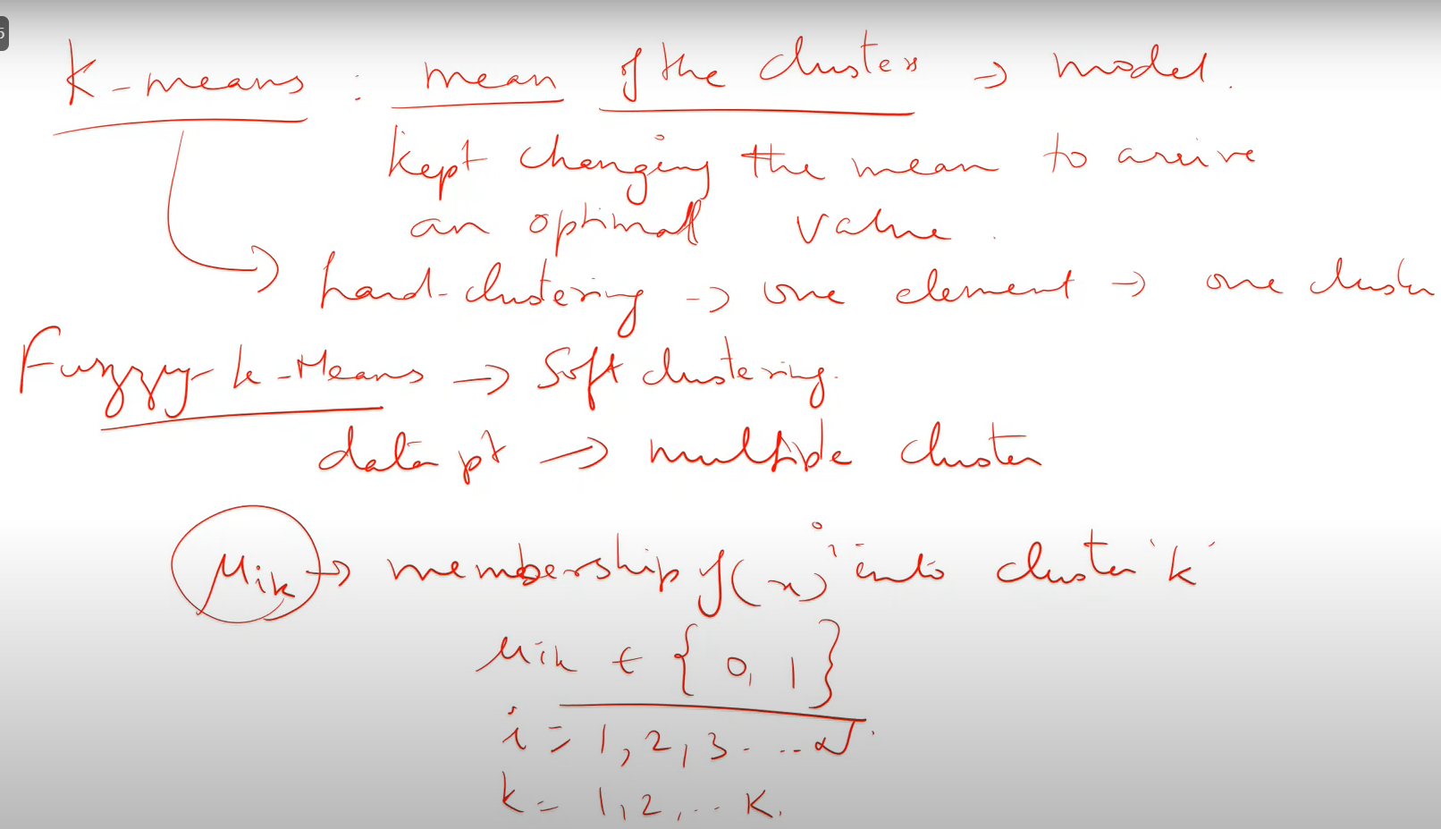

Slide 73
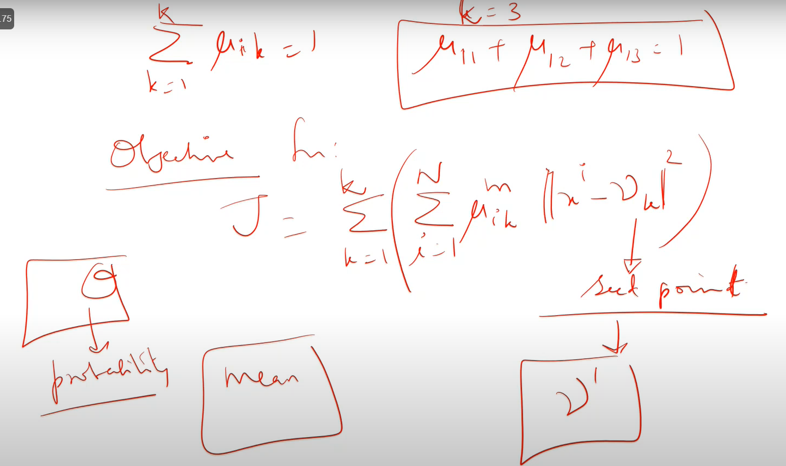

Slide 74
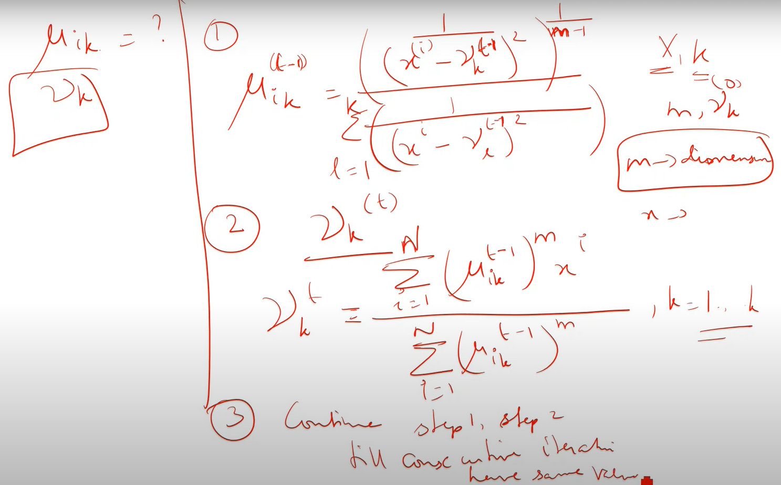

Slide 75
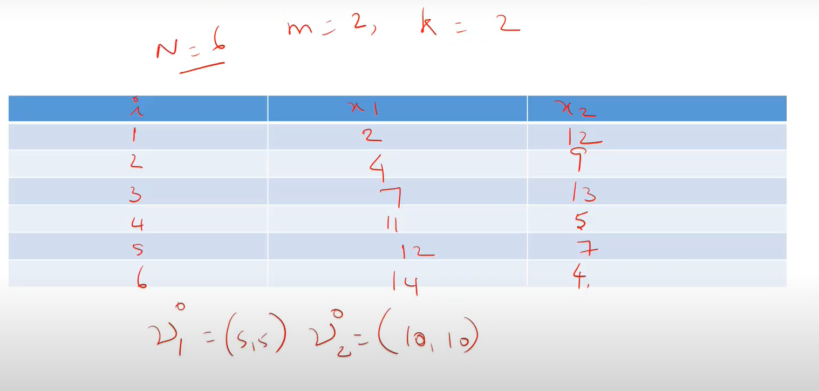

Slide 76
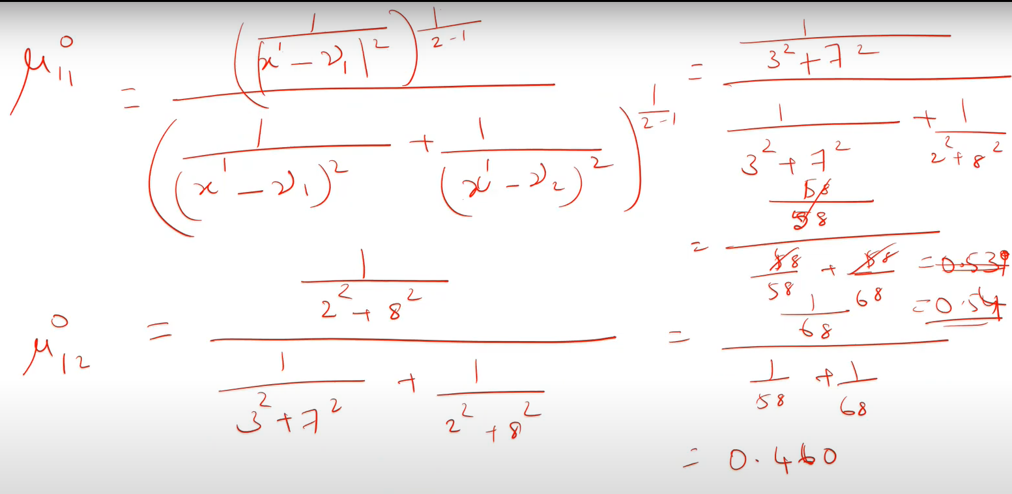

Slide 77
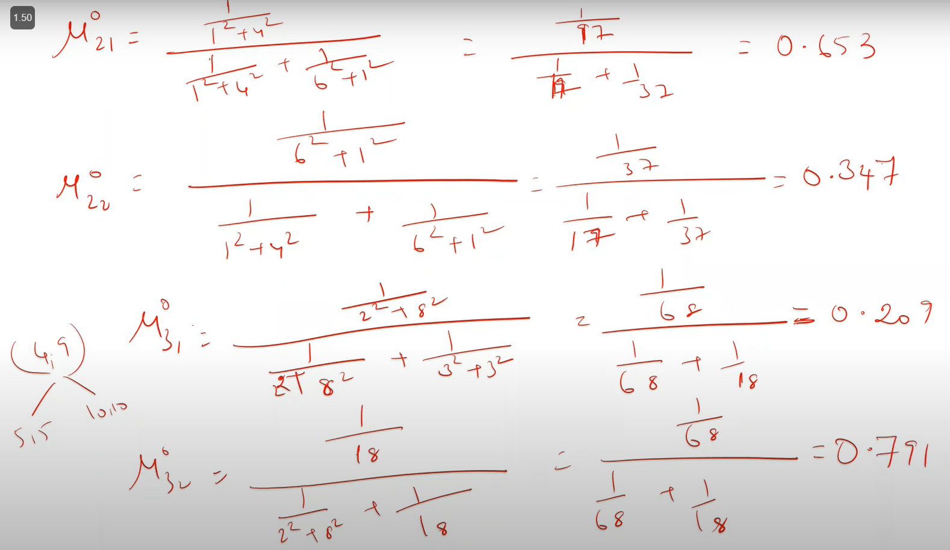

Slide 78
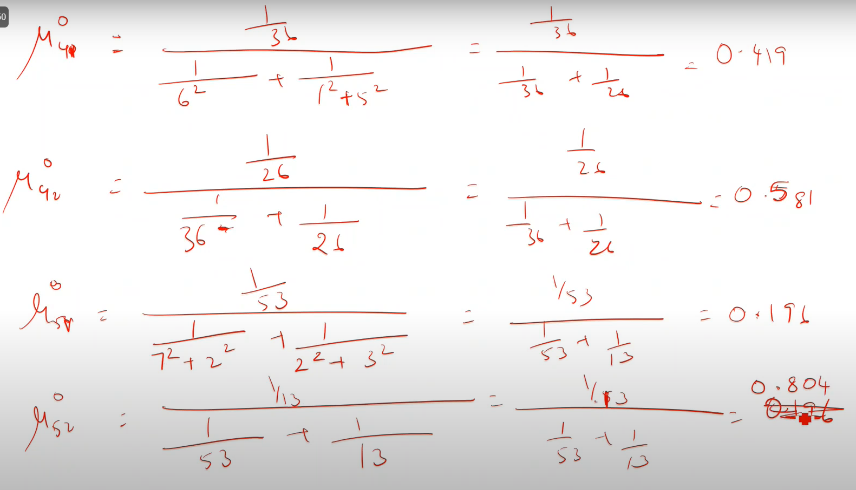

Slide 79
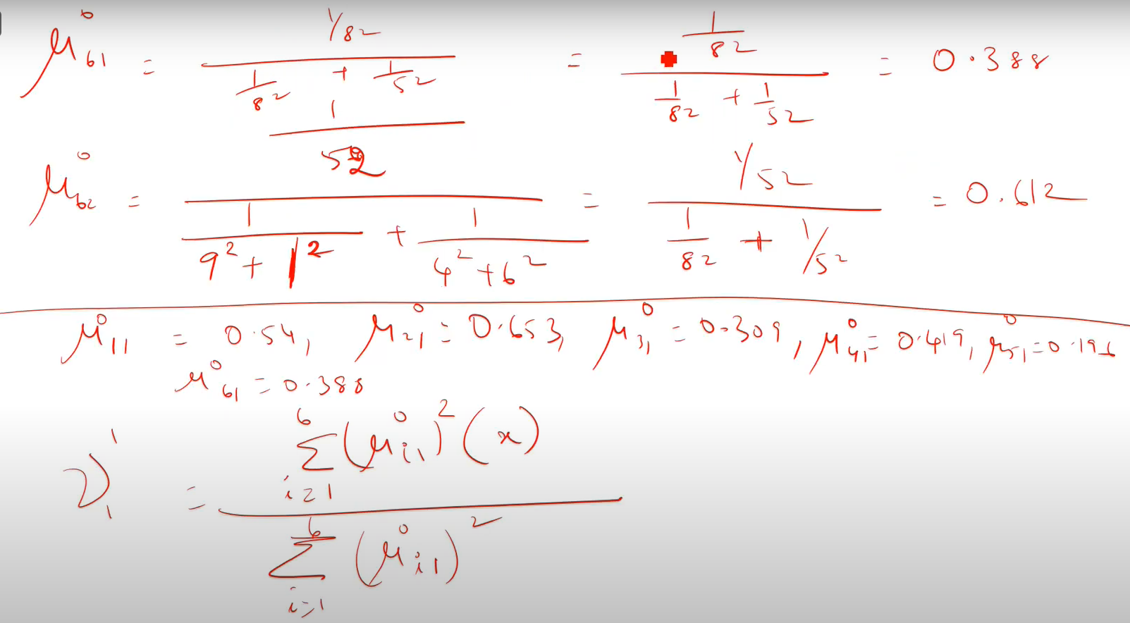

Slide 80
